Slide 1
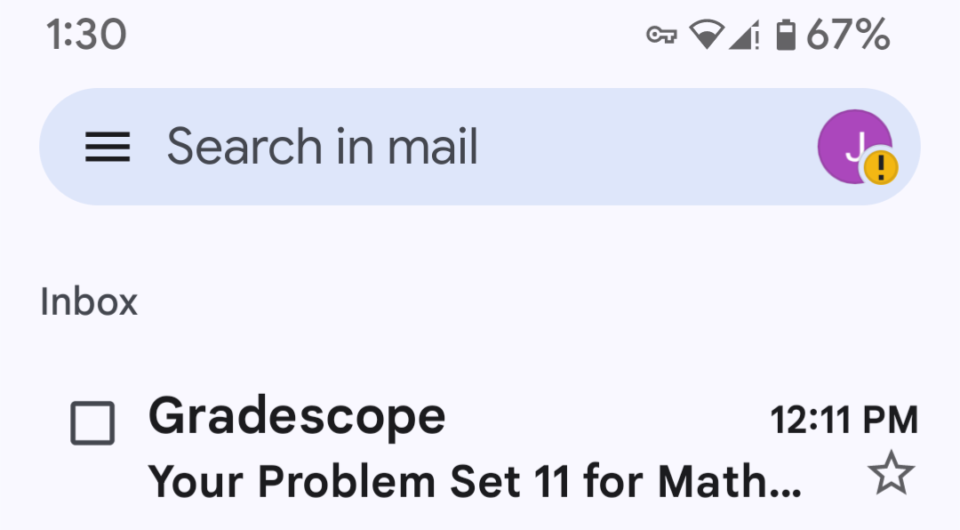
What do you do when you receive your homework feedback?

Slide 2
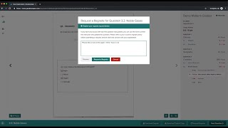
Viewing feedback

Slide 3
What should you do with the feedback?
Take a few minutes to brainstorm.

Slide 4
A few suggestions:
Check the solutions to any problems you made mistakes on. (You can find these on the Worksheets & Homework page of Canvas.)
Compare this to your own thought process for the problem. (If you have a hard time figuring out your thought process, it would be helpful to add small notes about process on upcoming assignments so these can be a useful tool for your future self.)
Identify how your thought process differed, and determine why it was incorrect. We strongly recommend jotting down notes onto your problem set or adding it to a study guide if the same issue comes up more than once!
If you still aren’t sure what was wrong with your answer, ask in office hours!

Slide 5


